Slide 1
Creativity and Innovation

Slide 2
To strive and thrive you need creative ideas
….downsizing tends to make us timid when we need to be bold
….the creative employees are the ones that will survive

Slide 3
The Creative Process
The work environment
Traits
The four step creative process
Brainstorming
Divergent thinking

Slide 4
The Creative Process
…..is anything but orderly
…..has no respect for time

Slide 5
The Creative Process
The work environment
Traits
The four step creative process
Brainstorming
Divergent thinking

Slide 6
1. The environment that supports creativity….
The size of the team is critical
Think about where you come up with your more creative ideas
A passion for what they were doing, a genuine respect for others’ ideas

Slide 7
The Creative Process
The work environment
Traits
The four step creative process
Brainstorming
Divergent thinking

Slide 8
2. Traits of creative people
Simply believing you’re creative
Curiosity
Confidence
Courage
Constancy
Drive to achieve
Love their work
Take risks
They understand the creative process itself

Slide 9
2. BARRIERS TO CREATIVITY
Excessive focus on extrinsic motivation
Limits set by superiors
Critical evaluation
Close, controlling supervision
Competition in a win-lose situation
Control of decision making
Control of information
Blindly following the rules
Constantly being practical
Becoming overly specialized
Fearing looking foolish
Fearing mistakes and failure

Slide 10
The Creative Process
The work environment
Traits
The four step creative process
Brainstorming
Divergent thinking

Slide 11
3. The 4-step Creative Process
Preparation
Incubation
Inspiration
Insight
Verification

Slide 12
Preparation
Gather data
Subject-specific
Divergent
Discover new opportunity or a problem that needs resolution.

Slide 13
Incubation
Steps to achieve “alpha state”
Assembled information in mind
Close your eyes
Slow, deep breaths
Focus on a single image

Slide 14
Inspiration
Be prepared to act
Don’t waste a good idea

Slide 15
Insight
The problem-conquering solution flashes into the person's mind at an unexpected time.
Unexpected time such as on the verge of sleep, during a shower, or while running.

Slide 16
Verification
Ideas are common…..
gathering supporting evidence, using logical persuasion, and experimenting with new ideas.
…it takes more than merely a good idea

Slide 17


INNOVATION
Innovation is the implementation of new ideas at the individual, group or organizational level.
A process of intentional change made to create value by meeting opportunity and seeking advantage.
Process: Innovation is a process (implying, among other things, that it can be learned and managed).
Intentional: That process is carried out on purpose.
Change: It results in some kind of change.
Value: The whole point of the change is to create value in our economy, society and/or
individual lives.
Opportunity: Entrepreneurial individuals enable tomorrow's value creation by exploring for it today: having ideas, turning ideas into marketable insights and seeking ways to meet opportunities.
Advantage: At the same time, they also create value by exploiting the opportunities they
have at hand.

Slide 18
THE INNOVATION PROCESS
Analytical planning – Carefully identifying the product or service
features, design as well as the resources that will be needed.
Resource organization – Obtaining the required
resources, materials, technology, human or capital resources.
Implementation – Applying the resources in order to accomplish the plans
Commercial application – The provision of value to customers, reward
employees, and satisfy the stake holders.

Slide 19

CREATIVITY, INNOVATION AND ENTREPRENEURS
Creativity is thinking new things, and innovation is doing new things.
Creativity is the ability to develop new ideas and to discover new ways of looking at problems and opportunities.
Innovation is the ability to apply creative solutions to those
problems and opportunities in order to enhance people‟s lives or
to enrich society.
Entrepreneurship = creativity + innovation

Slide 20
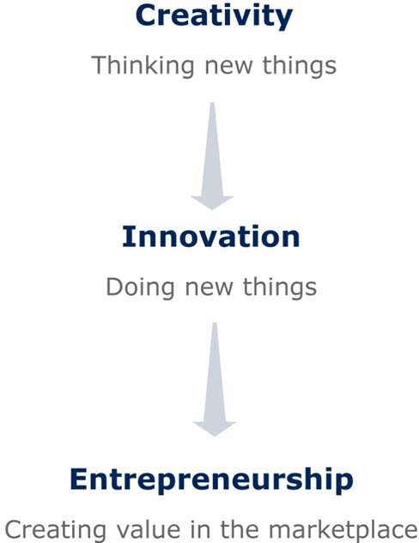
FROM CREATIVITY TO ENTREPRENEURSHIP

Slide 21
CREATIVITY, INNOVATION AND ENTREPRENEURS
Creativity is the ability to develop new ideas and to discover new ways of looking at problems and opportunities.
Innovation is the ability to apply creative solutions to those problems and opportunities in order to enhance people‟s lives or to enrich society.
Entrepreneurship is the result of a disciplined, systematic process of applying creativity and innovation to needs and opportunities in the marketplace.
Entrepreneurs are those who marry their creative ideas with the purposeful action and structure of a business.
Researchers believe that entrepreneurs succeed by thinking and doing new things or old things in new ways.

Slide 22
SOURCE OF NEW IDEA
Basic research : all firms are engaged in some kind of basic research and development , which can lead to development of new product ideas that have already passed the initial screening stage.
Production stage : workers actively engaged in the production of products can suggest certain modifications and improvements. These workers can provide ideas aimed at improving quality , cost and performance of potential product.
Sales force : sales representative are directly in touch with the customers and are thus better equipped to take note of customer needs by this they can provide better product development idea.
Management : management team based on their knowledge, skill and experience can come out with new ideas for product development.

Slide 23
SOURCE OF NEW IDEA
Magazines and trade journal : useful ideas about new products can be obtained from these magazines and trade journals.
Competitors : in order to survive in present day competitive environment, it is in the interest of the entrepreneur to keep a eye on activities of his rivals.
Buyers : an entrepreneur while keeping track of the requirements of the consumers can definitely get useful ideas aimed at developing a better product.
Sellers : can provide idea for new product development as they act as link between producers and consumers and are better equipped to provide required information.
Overseas market : a producer interested in taking care of foreign market can do it in better manner by getting right ideas aimed at improving product acceptability in these markets.

Slide 24
IDEAS INTO OPPORTUNITIES
New product idea
Concept developm ent
Potential
analysis
Product developm ent
Test
marketing
Commerc
ialization
Idea
screening

Slide 25
IDEAS INTO OPPORTUNITIES
New product idea : an attempt is made to visualize the product. An in depth study may be undertaken to anticipate features of the proposed product. Ideas may be contributed by scientists, professional designers, rivals, customers, sales force etc.
Idea screening : under this step detailed investigation of various ideas is carried on. Those ideas which offer less scope are dropped. Most promising ideas are chosen for product development.
Concept development and testing : all ideas chosen after preliminary screening are subjected to in depth study. These ideas are developed into mature product concepts.
Business potential analysis : after choosing best product idea, detailed investigation is carried out to find its market potential, gestation period, capital investment, and expected rate of return.

Slide 26
Product development : after clearing business potential analysis tests concrete steps are taken for giving practical shapes to the proposed product.
Test marketing : test marketing involves placing fully developed new product for sale and observing its actual performance under propose marketing plan.
Commercialization : is the actual introduction of the product into market place with all the related decisions and resources commitment.

Slide 27
THANK YOU

